Slide 1
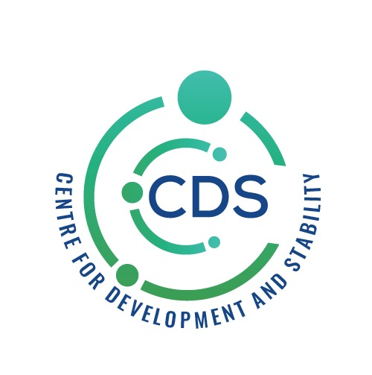

Slide 2
CPEC
ASSESSING THE TRANSFORMATION OF VISION INTO REALITY

Slide 3
PROGRESS AND DEVELOPMENT IN BALOCHISTAN
How countries are developing ???
Importance of bilateral ties
Pakistan and China All –Weather friends
Both countries are committed to enhance peace in the region
Reduce trust deficit Through strong bilateral ties and cordial relation
Personal observations and ground realities
Chinese are welcoming and have soft corner for Pakistani people

Slide 4
Factors
CPEC GAME CHANGER.. A Project of 62bnUSD
Energy, Industry, Agriculture, IT, Disaster prevention and road connectivity.
Made significant contributions to promoting Pakistan’s Economy and social Development, Enhancing people to people contact and Deepening regional connectivity.
CCCPK(China chamber of commerce in Pakistan) facilitating implementation, it consists of many companies .

Slide 5

PROJECTS IN BALOCHISTAN
On July 27, 2023,Prime Minister Shahbaz Sharif then inaugurated 14 projects’ construction and completion in Gwadar, such as the completion of Gwadar International Airport and the Gwadar Seawater Desalination Plant with a daily output of 5,000 tons of desalinated water aided by the Chinese government
They inaugurated the dredging project of Gwadar Port, Gwadar University, and the 132 kV DC power transmission of the State Grid including the construction project.
Gwadar international airport project covers an area of about 18 square kilometers. It includes a new airport flight area project (4F, runway length 3658 meters) and a terminal area project (including a terminal building area of 14,000 square meters
One of the biggest airport , approximately cost is 54.98bn i.e 240M USD
MRDL is a Chinese company is working in Saindak.
Completed the On-load Trial Run of 2.75 MT/A Concentrate Expansion Project at Saindak MRDL just completed the on-load trial run of its 2.75 MT/A Concentrate Expansion Project at Saindak. With nearly 100 million US dollars and increased capacity, MRDL is about to bring more job opportunities and empower the Balochistan economy where it is in operation.

Slide 6
Since operating the Saindak project MRDL has invested nearly 20 Million US $ in CSR activities.
MRDL funds the operation Saindak high school.
MRDL runs the hospitals open to the public and charging only 50% of the medical fees.
Builts Water and power supply facilities for the local community.
Offer natural disaster relief to the community.
MRDL has provided five million us dollar in direct donations and disaster relief to people institutions and organizations in Pakistan during the past 20 years.
In addition to sending over RS 20 million worth of living supplies Chagai and surroundings.
MRDL has donated RS 43 Million to the Balochistan gov to help fight against the covid.
MRDL has also donated 250000$ to the flood relief fund of Balochistan in 2022.

Slide 7
SECOND PHASE
Green infrastructure ,renewable energy and sustainable finance.
CECPK is focused to enhance the economic and social corporation between locals and member corporation.
South China commidity exhibition sports.
Chinese companies are transforming desert into green.

Slide 8
Power China
It has completed 47 various projects in Pakistan
The total value of these projects in 6.2Billion US dollar
.
25 projects are currently being executed with total value of 5B$ approx
Power china provided training to 11000 local stuff
.

Slide 9
Future of CPEC
JOB OPPORTUNITIES
1
3
AGRICULTURE
TECHINCAL EDUCATION
2
4
DEVELOPMENT

Slide 10
Thank You

